Slide 1

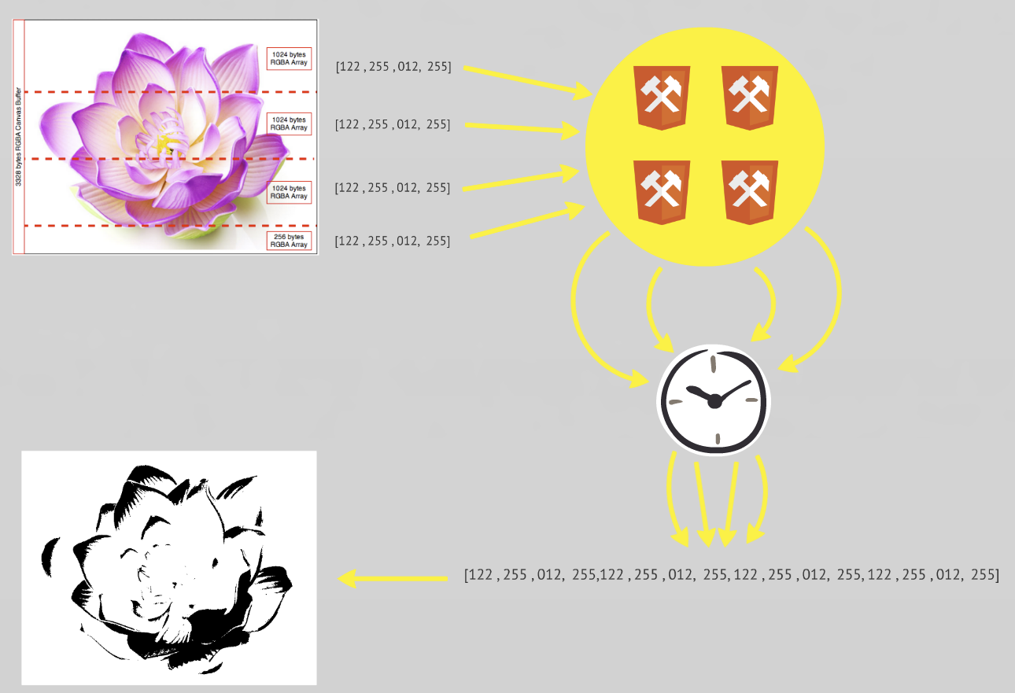
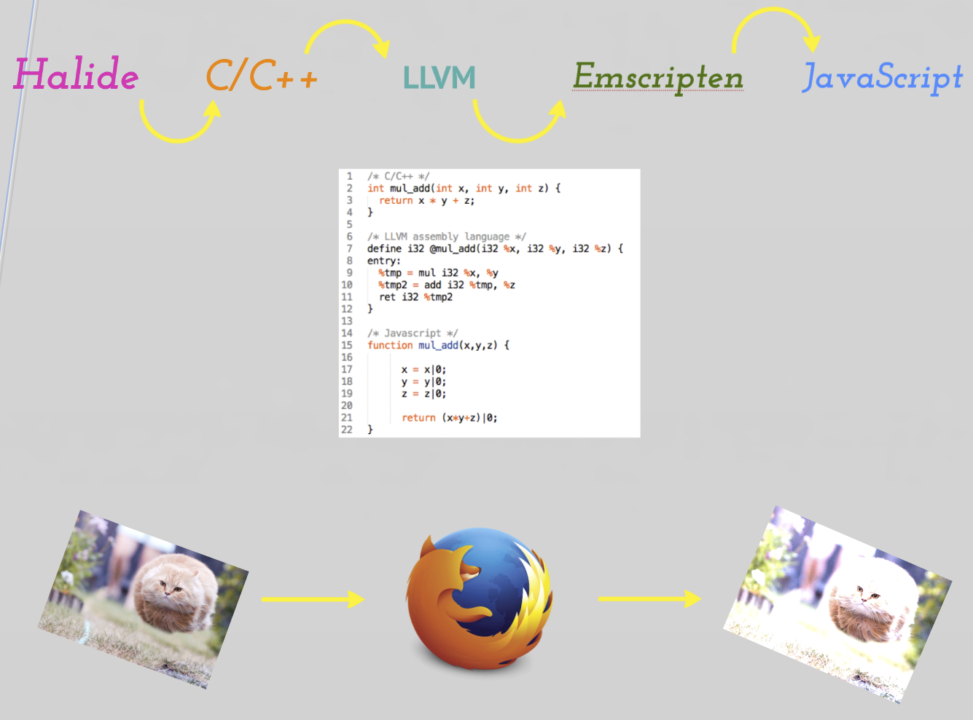
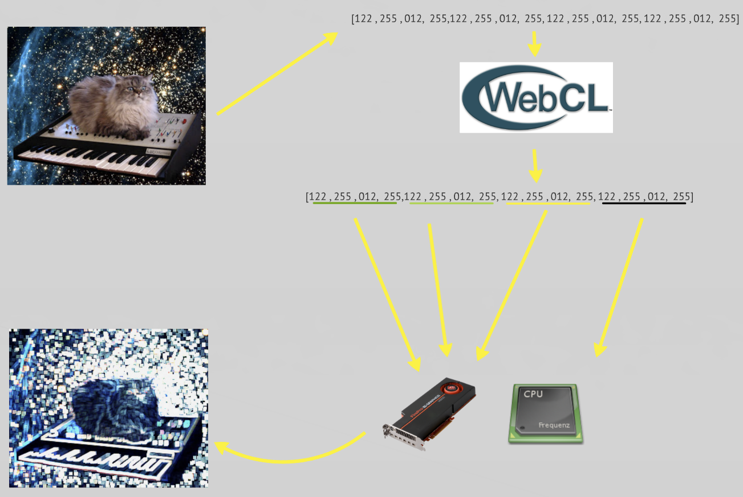
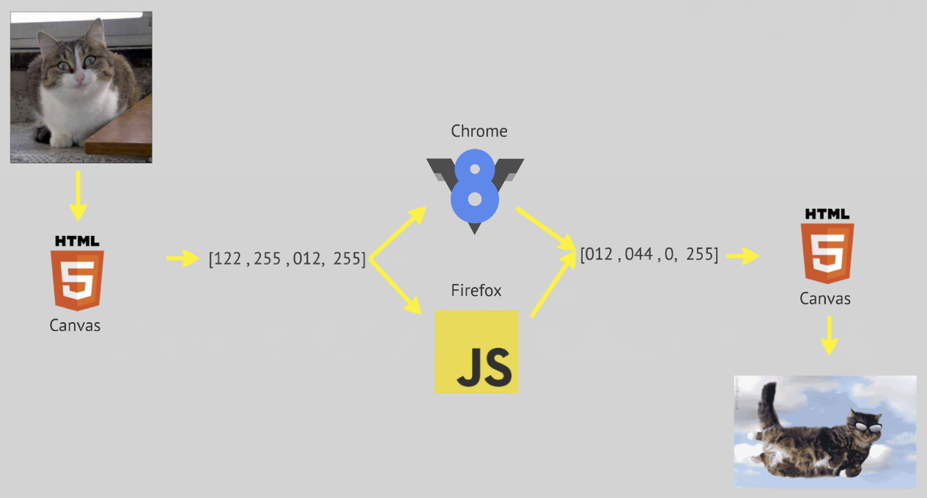
A Study of High Performance Image Processing in the Browser
Victor O. Santos Uceta, Joel Brandt
Adobe Creative Cloud
Summer 2014
Abstract
Web Workers
This study explores the possibilities of executing complex image processing algorithms inside the browser at high speed. Using experimental technologies/researches and official standards, this study explores the possibilities of moving native high performance image processing software (such as Photoshop) to a web environment by using the heterogeneous resources of modern computing and recent compiling tools.
Web Workers distributed image processing
Emscripten + Halide
WebCL
Emscripten and Halide compilation pipeline
WebCL execution flow
Plain JavaScript
Benchmark
Gray-scale filter
Blur filter
269MB of RGBA data (8400px. x 8400px.)
Grey: Plain JavaScript, Red: WebCL, Blue: Web Workers.
Lower is better.
Simple image processing using plain JavaScript

